Slide 1
HOUSING: PRICE PREDICTION
• Which variables are important to predict the price of variable?
• How do these variables describe the price of the house?

Slide 2
pd.set_option("display.max_rows",None) pd.set_option("display.max_columns",None) Display of rows and columns completely
df=pd.read_csv('train.csv’)
df
Train dataset imported with df as variable of data inserted

Slide 3
df.shape 1168 rows & 81 columns df.dtypes Maximum data is categorical while some is float
sns.heatmap(df.isnull())
df.isnull().sum()
Heat map shows data is huge amount of Null or missing values

Slide 4
Treating Null values
# we are having null values in our dataset, inorder to proceed further we need to treat null values
# we will treat them one by one
# we have a lot of missing values in these columns, replacing these values with anything may lead to data bias as these are categorical.
# column named lotfrontage is float with 214 Nan values but it is not replaced but dropped so that data don't get bias
# Hence decided to drop these columns
# 1. LotFrontage (linear feet of street connected to property)
# 2. Alley (type of alley access to property)
# 3. FireplaceQu (Fireplace quality)
# 4. PoolQC (pool quality)
# 5. Fence (Fence Quality)
# 6. MiscFeature (Miscellaneous feature not covered in other categories)
df.drop(columns=["LotFrontage","Alley","FireplaceQu","PoolQC","Fence","MiscFeature"],inplace=True)

Slide 5
df.shape (1168,75) It gave new shape with drop of columns Now we have replaced rest of the Nan values in left columns with mode
df["MasVnrType"]=df["MasVnrType"].fillna(df["MasVnrType"].mode()[0])
df["MasVnrArea"]=df["MasVnrArea"].fillna(df["MasVnrArea"].mode()[0])
df["BsmtQual"]=df["BsmtQual"].fillna(df["BsmtQual"].mode()[0])
df["BsmtCond"]=df["BsmtCond"].fillna(df["BsmtCond"].mode()[0])
df["BsmtExposure"]=df["BsmtExposure"].fillna(df["BsmtExposure"].mode()[0])
df["BsmtFinType1"]=df["BsmtFinType1"].fillna(df["BsmtFinType1"].mode()[0])
df["BsmtFinType2"]=df["BsmtFinType2"].fillna(df["BsmtFinType2"].mode()[0])
df["GarageType"]=df["GarageType"].fillna(df["GarageType"].mode()[0])
df["GarageYrBlt"]=df["GarageYrBlt"].fillna(df["GarageYrBlt"].mode()[0])
df["GarageFinish"]=df["GarageFinish"].fillna(df["GarageFinish"].mode()[0])
df["GarageQual"]=df["GarageQual"].fillna(df["GarageQual"].mode()[0])
df["GarageCond"]=df["GarageCond"].fillna(df["GarageCond"].mode()[0])
# no null values are there now
df.isnull().sum()

Slide 6
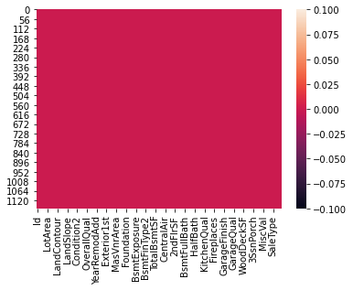
# checking null values with heat map now, no null values available sns.heatmap(df.isnull())
# finding correlation b/w eachother
dfcor=df.corr()
Dfcor
# we can put this correlation into a heat map plt.figure(figsize=[22,12]) sns.heatmap(dfcor,annot=True) plt.title('housing project') plt.show()

Slide 7
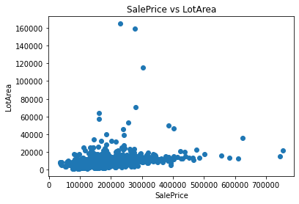
Data Visualization # we will start with scatter plot
# There is a positive relation b/w SalePrice & LotArea
# The lotarea increase means increase in price
x=df['SalePrice']
y=df['LotArea']
plt.scatter(x,y)
plt.title('SalePrice vs LotArea')
plt.xlabel('SalePrice')
plt.ylabel('LotArea')
plt.show()
#Like this we created several scatter plots b/w target variables and rest of factors to visualize the positive or negative relationship b/w them.

Slide 8
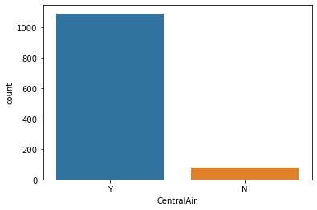
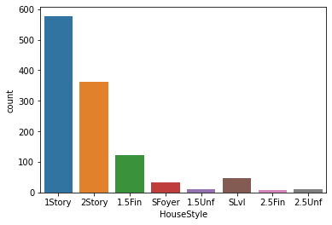
Countplot
#Most of the houses are having central air conditioning systems
sns.countplot(df["CentralAir"])
#countplot shows us factors like yes or no, type of categories and their availability which effects the sale price
# Most of the house are one story followed by two story house on 2nd position
sns.countplot(df["HouseStyle"])

Slide 9
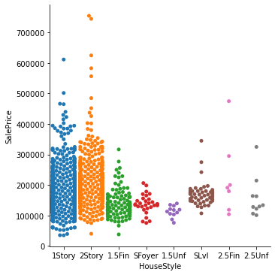
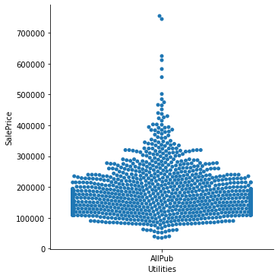
CATPLOT
# Two story are on the higher sale price followed by one story.
# The above data also shows us that most of the properties are one and two story.
sns.catplot(x="HouseStyle", y="SalePrice",kind="swarm",data=df)
# All properties the train data set is having all basic utilities avialable i.e. Electricity, Gas, and Water (Septic Tank)
sns.catplot(x="Utilities", y="SalePrice",kind="swarm",data=df)

Slide 10
Handling Categorical Data # Here we are handling categorical data by converting it into numerical data through LabelEncoder df["MSZoning"].value_counts() # As this is case of Ordinal Categorical type we perform LabelEncoder # Here Values are assigned with corresponding keys df.replace({"RL": 0, "RM":1,"FV":2,"RH":3,"C (all)":4}, inplace = True) # Replacing categorical data in a column with numeric like 0,1,2,3,4,5

Slide 11
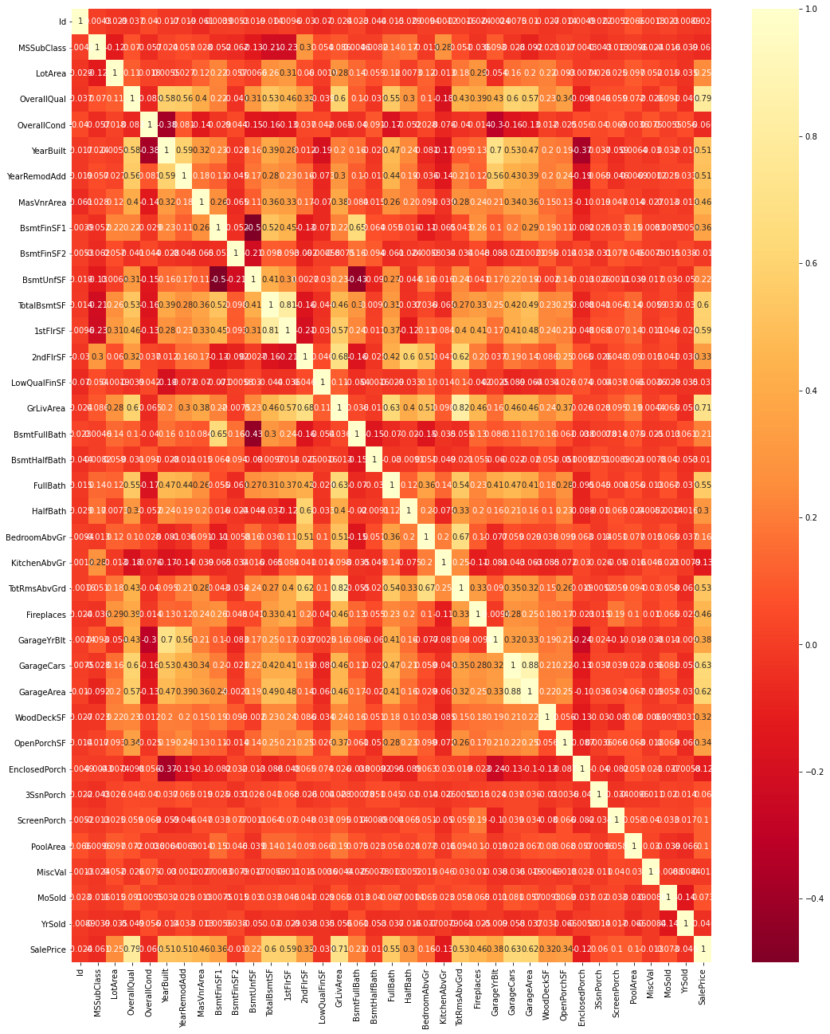
# checked correlation after label encoder sns.color_palette? sns.heatmap? plt.figure(figsize=(18,22)) sns.heatmap(dfcor,cmap='YlOrRd_r',annot=True)

Slide 12
Treating Skewness for col in df: print(col) print(skew(df[col])) plt.figure() sns.distplot(df[col]) plt.show() # distribution plot will help us to know skewness in all columns x=df.drop("SalePrice",axis=1) y=df["SalePrice"] # Here we are dropping the target variable SalePrice and to find the skewness of rest of columns df.skew() # It shows skewness in each column in numeric form Power Transform Method from sklearn.preprocessing import power_transform df_new=power_transform(x) df_new=pd.DataFrame(df_new,columns=x.columns)

Slide 13
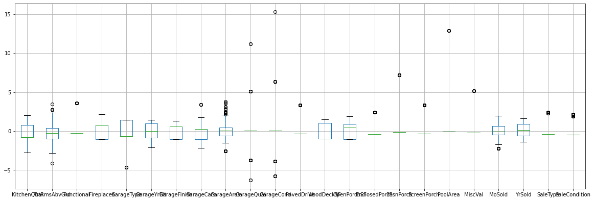
checking outliers # plotting box for first 25 rows x.iloc[:,0:25].boxplot(figsize=[20,8]) plt.subplots_adjust(bottom=0.25) plt.show() # Boxplot is used to check outliers

Slide 14
Removing outliers and Z-score # finding Zscore value b/w +3 to -3 z=np.abs(zscore(df)) z threshold=3 print(np.where(z>3)) z[1][8] # finding Interquantile IQR=Q3-Q1 IQR # True shows outliers are present & False shows not print((df<(Q1-(1.5*IQR)))|(df>(Q3+(1.5*IQR))))

Slide 15
Importing Test Set # We treat the test set data just like we did for training set till converting all categorical data to Numerical data

Slide 16
Split the data into training and testing sets from sklearn.model_selection import train_test_split # splits the training and test data set in 80% : 20% # assign random_state to any value.This ensures consistency. x_train, x_test, y_train, y_test = train_test_split(x, y, test_size = 0.2, random_state=5) print(x_train.shape) print(x_test.shape) print(y_train.shape) print(y_test.shape) # it will give us the shape (rows & columns) for (x,y) for test and train #Train the model using sklearn LinearRegression from sklearn.linear_model import LinearRegression from sklearn.metrics import mean_squared_error, r2_score lin_model = LinearRegression() lin_model.fit(x_train, y_train) # We do model evaluation for test and train set

Slide 17
from sklearn.ensemble import RandomForestRegressor reg_rf = RandomForestRegressor() reg_rf.fit(x_train, y_train) # We do model evaluation for test and train set # We check root mean square error of the model and R2 score

Slide 18
from sklearn.tree import DecisionTreeRegressor dtr=DecisionTreeRegressor() dtr.fit(x_train, y_train) # We do model evaluation for test and train set # We check root mean square error of the model and R2 score

Slide 19
Considering the Values in all three model building methods the perfect score comes of DecisionTreeRegressor

